Slide 1

Predicting Length of Stay at Admission for Cardiac Patients
DSIA Capstone Project Presentation
4 June 2020
Luiz Augusto Carneiro
Data Scientist

Slide 2
AGENDA
BIO AND ACKNOWLEDGEMENTS
1
2
PROJECT CONTEXT
DEFINE
3
4
DESIGN
DELIVER
5
6
SUMMARY, CONCLUSIONS
AND NEXT STEPS

Slide 3
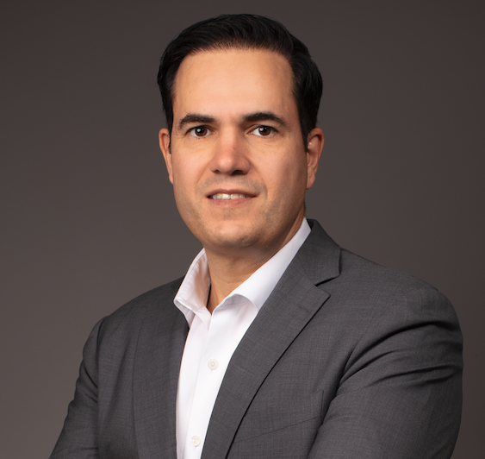
BIO
Data Scientist
PhD in Actuarial Studies (UNSW)
Master's Degree in Economics
Health Actuary and Economist
Executive courses at the Harvard T.H. Chan School of Public Health
Project Consultant for Roche
Former leader at the IESS (Brazilian think tank for the private healthcare sector)

Slide 4


ACKNOWLEDGEMENTS
I would like to express my deepest appreciation to Dr. Tania Grillo and Dr. Renato Couto for providing me with the dataset used in this project.

Slide 5
AGENDA
BIO AND ACKNOWLEDGEMENTS
1
2
PROJECT CONTEXT
DEFINE
3
4
DESIGN
DELIVER
5
6
SUMMARY, CONCLUSIONS
AND NEXT STEPS

Slide 6
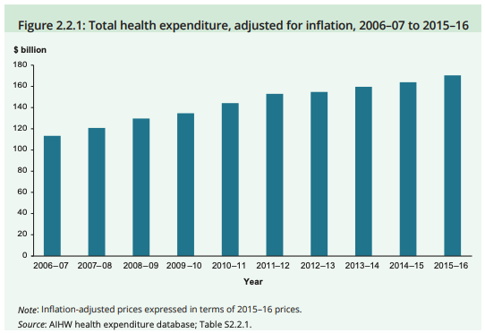
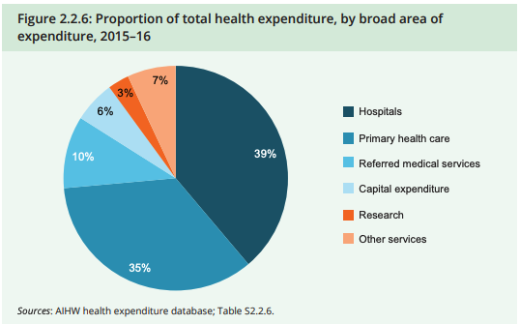
HOSPITALISATIONS AND Healthcare Expenditure in Australia
Health expenditure has been rising above inflation in Australia.
Hospitalisations account for almost 40% of the total health expenditure
Source: https://www.aihw.gov.au/getmedia/941d2d8b-68e0-4883-a0c0-138d43dba1b0/aihw-aus-221-chapter-2-2.pdf.aspx
Notes:
Total expenditure on health increased each year in real terms (after adjusting for inflation), from $113 billion in 2006–07 to $170 billion in 2015–16—an annual average rate of 4.8% (39% x $170 BB = $ 66.3 BB)

Slide 7
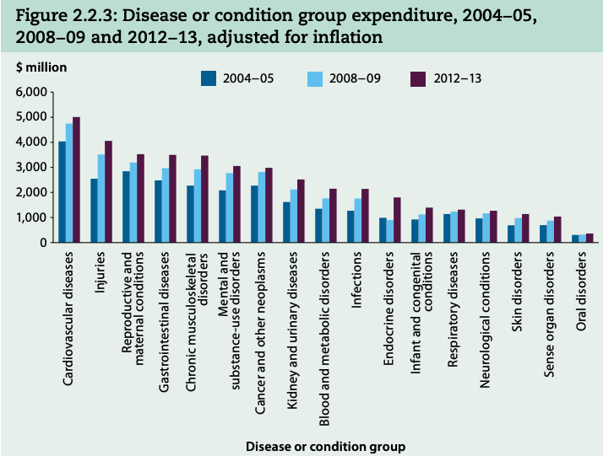
Health expenditure with cvd ADMITTED PATIENTS
The Cardiovascular diseases (CVD) group is responsible for the most expenditure for admitted patients
In 2012–13, around $5 billion of total admitted patient expenditure (11.1%) was related to Cardiovascular diseases.
There were almost 1.2 million hospitalisations where CVD was recorded as the principal and/or additional diagnosis in 2016–17. This represents 11% of all hospitalisations in Australia.
Source: https://www.aihw.gov.au/getmedia/3be568f2-d938-4575-bf1f-8742bad4d2ce/ah16-2-2-how-much-does-australia-spend-on-health-care.pdf.aspx

Slide 8
AUSTRALIAN ANNUAL EXPENDITURE WITH CVD HOSPITALISATIONS
Therefore, the estimated annual expenditure with CVD hospitalisations in Australia is:
$8.14 billion
(improving efficiency by 1% means saving $81.4 million)
During 2017–18, a total of $74 billion was spent on Australia's public and private hospitals.
Source: https://www.aihw.gov.au/getmedia/91e1dc31-b09a-41a2-bf9f-8deb2a3d7485/aihw-hwe-77-25092019.pdf.aspx

Slide 9


THE ISSUE OF LENGTH OF STAY (LOS) IS A VERY IMPORTANT ONE
There have been may studies on LOS over the past decades.
“Extended lengths of stay are a drain on hospital resources, personnel and the bottom line, costing hospitals millions of dollars a year.”
Source: https://go.beckershospitalreview.com/how-predicting-patient-length-of-stay-enables-hospitals-to-save-millions

Slide 10
AGENDA
BIO AND ACKNOWLEDGEMENTS
1
2
PROJECT CONTEXT
DEFINE
3
4
DESIGN
DELIVER
5
6
SUMMARY, CONCLUSIONS
AND NEXT STEPS

Slide 11
STAKEHOLDERS, BUSINESS QUESTION AND DATA QUESTION
STAKEHOLDERS: patients, healthcare providers, suppliers and payers.
BUSINESS QUESTION:
How can we predict LOS so hospitals are able to identify patients who might be at risk for an extended stay, and subsequently alter a patient's treatment plan from the point of admission to reduce the hospital stay?
DATA QUESTION:
Which patient’s characteristics at admission at the hospital better explain the LOS?
Obs.: we focus on CVD hospitalisations, but this analytical method could also be applied to all types of hospitalisations.

Slide 12
AGENDA
BIO AND ACKNOWLEDGEMENTS
1
2
PROJECT CONTEXT
DEFINE
3
4
DESIGN
DELIVER
5
6
SUMMARY, CONCLUSIONS
AND NEXT STEPS

Slide 13
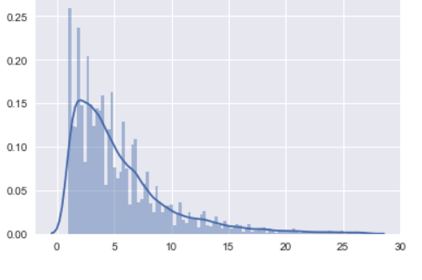
DATA EXPLORATION, ANALYSIS AND VISUALISATION
The data comes from DRG Brasil ®
Distribution of Length of Stay (LOS)
19,431 CVD hospitalisations
Number of Days at Hospital
Selected variables (features) for patient’s “intrinsic health risk:
Age, sex and 354 variables for diagnosis (including comorbidities and conditions)

Slide 14
PROJECT PIPELINE
Context and Objective
Stakeholders
Business Question
Business Answer
Data Question
Data
Answer
DATA
Data Analysis
Feature Selection
Modeling and Validation
SOLUTION

Slide 15
AGENDA
BIO AND ACKNOWLEDGEMENTS
1
2
PROJECT CONTEXT
DEFINE
3
4
DESIGN
DELIVER
5
6
SUMMARY, CONCLUSIONS
AND NEXT STEPS

Slide 16
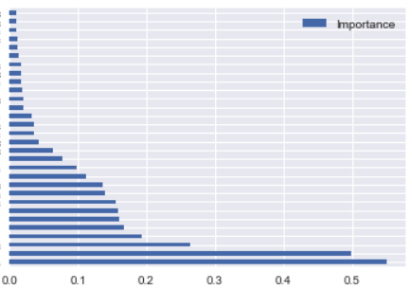
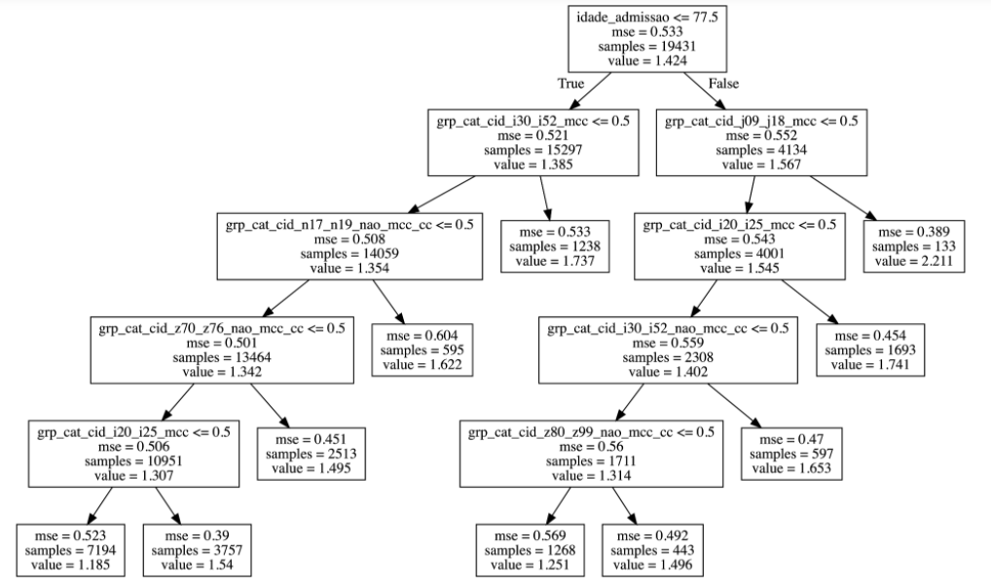
FEATURE SELECTION
① With Random Forest, we can select features by importance:
② and use them in a decision tree.
LoS = 4.19
Age > 77.5 ?
No
Yes
Age at admission
LoS = 4.02
LoS = 4.83
Other CVD ?
Flu / Pneum.?
No
Yes
No
Yes
LoS = 3.9
LoS = 5.75
LoS = 5.73
LoS = 9.3
Renal Insuff. ?
Ischemic Dis. ?
No
Yes
No
Yes
LoS = 3.85
LoS = 5.11
LoS = 4.09
LoS = 5.77

Slide 17
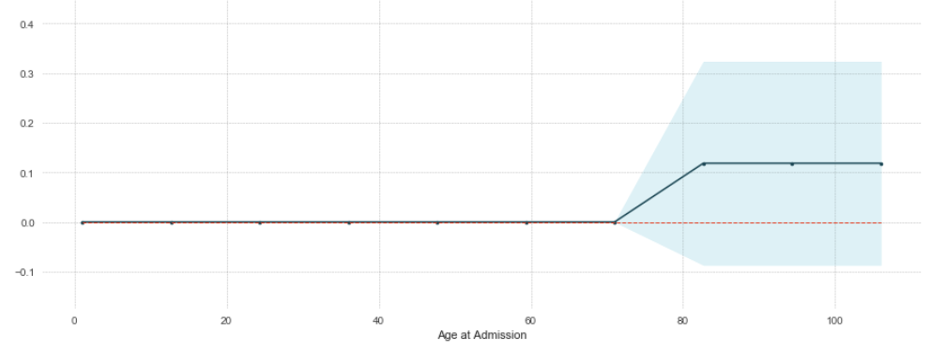
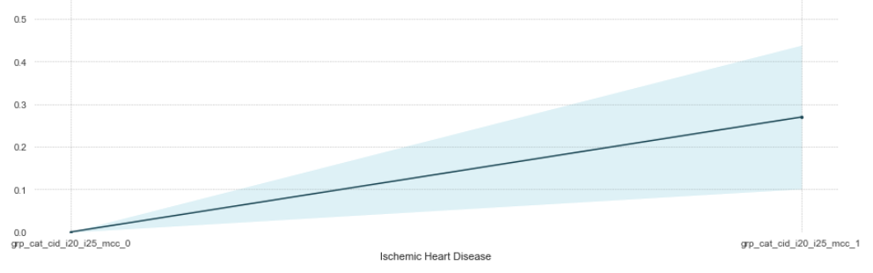
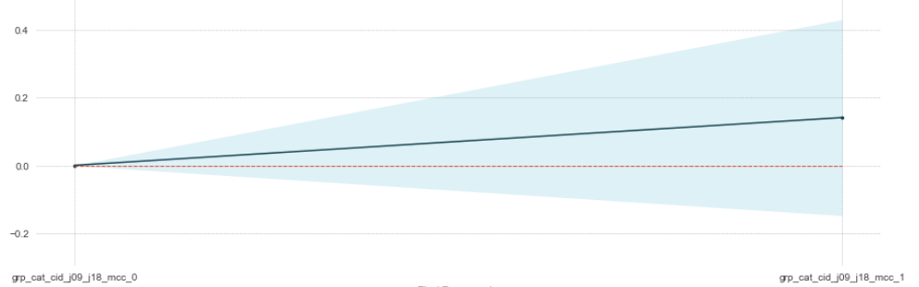
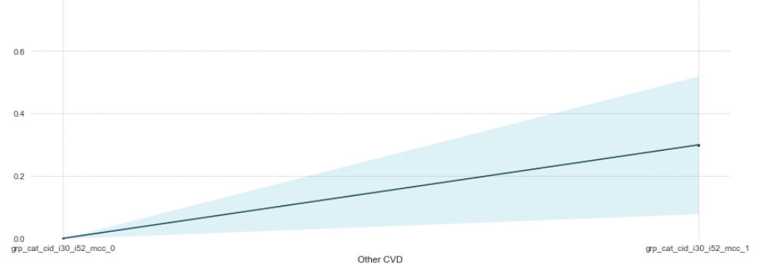
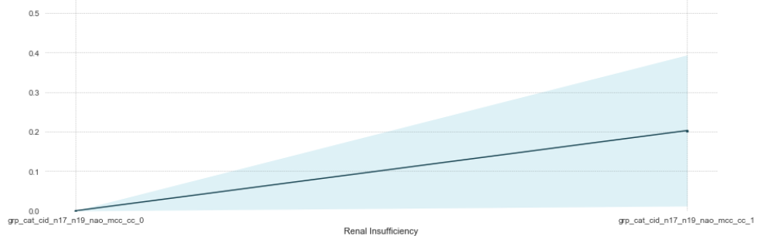
THE IMPACT OF EACH FEATURE ON LENGTH OF STAY
Partial dependence plots show the impact of each feature on LOS:
Age at admission
Ischemic heart disease
Flu / Pneumonia
Other CVDs
Renal Insufficiency

Slide 18
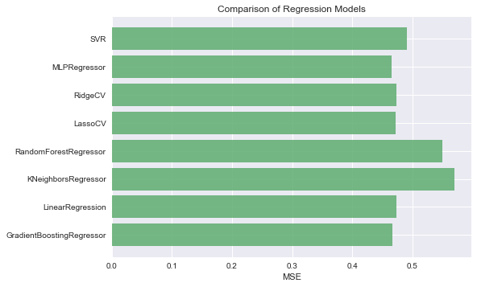
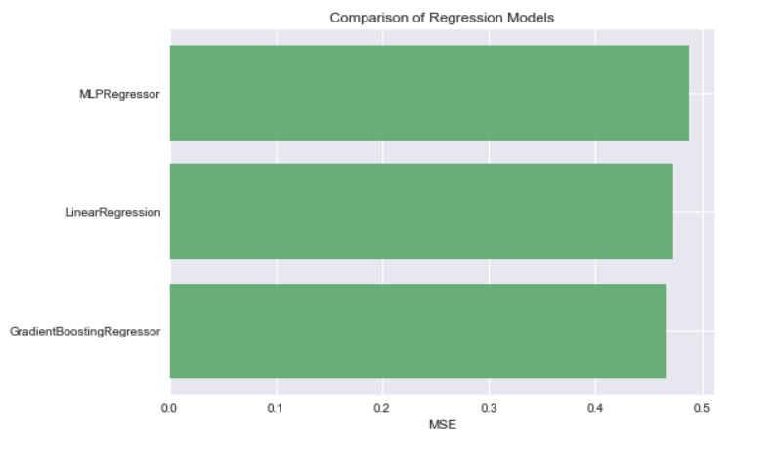
PREDICTIVE MODELS
Some Machine Learning models were trained and validated:
But these three models (including Linear Regression!) show the best performance.

Slide 19
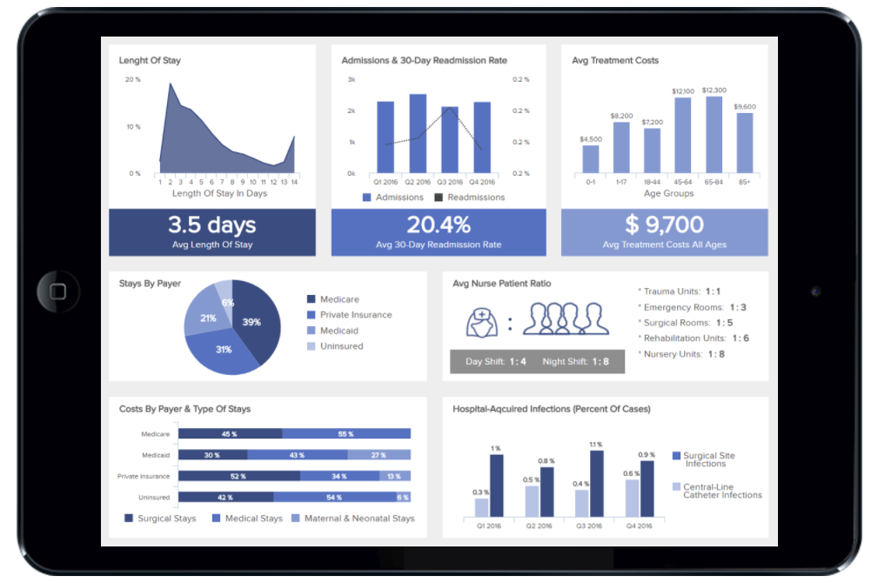
SOLUTION DELIVERY
The solution can be implemented in any hospital and the LOS predictions can be easily incorporated to existing applications.

Slide 20
AGENDA
BIO AND ACKNOWLEDGEMENTS
1
2
PROJECT CONTEXT
DEFINE
3
4
DESIGN
DELIVER
5
6
SUMMARY, CONCLUSIONS
AND NEXT STEPS

Slide 21
SUMMARY
Data
Approach
Outcomes
Select the most important features among the total of 356 features:
Use the most important features to predict the length of stay (LOS)
Decision trees provided insightful and valuable information: including the combination of features per patient.
Predictive models, including Linear Regression, performed well to predict the length of stay (LOS)
Data from 19,431 CDV hospitalisation
Target variable: Length of stay (LOS)
356 features:
1) Age at admission
2) Sex
3) 354 features for diagnosis, comorbidities and conditions.

Slide 22
CONCLUSIONS AND NEXT STEPS
CONCLUSIONS
NEXT STEPS
The analytical method properly identifies the most important features to predict LOS
The predictive models provide important information and can be easily implemented in existing platforms.
Continue the partnership with DRG Brasil ®:
1) Develop other types of models
2) Include other types of hospitalisations

Slide 23

THANK YOU
Do you have any questions?
carneiro_aus@yahoo.com.au linkedin.com/in/lacarneiro/ github.com/lacarneiro

